Slide 1
Predicting CSE Undergraduate Students’ Careers using Various Machine Learning and Ensemble Learning Algorithms in The Context of Bangladesh.
Presented By: Israt Jahan Reshma ID: 18CSE241 Session: 2018-19 Dept. of CSE, BSMRSTU | Thesis Supervisor: Dr. Saleh Ahmed Associate Professor Dept. of CSE, BSMRSTU

Slide 2
Presentation Outlines
Introduction
Literature Review
Methodology
Results
Challenges and Risks
Conclusion

Slide 3
INTRODUCTION[1/2]
20,000 Fresh CSE Graduate
On basic coding skills, mathematics, and English: 80%
Annual new technical personnel: 7,500 - 8,000.

Slide 4
Introduction[2/2]
Why I propose The Model ?
Large number of students studying Computer Science and Engineering (CSE) from Bangladesh
Choice of career path is complex due to numerous career options, job competitions and due to a lack of guidance.
Machine learning techniques have certain advantages for those who are still confused about choosing a career.
According to the survey conducted by the Council of Scientific and Industrial Research’s (CSIR), about 40% of students are confused about their career options.

Slide 5
Related Literature Review[1/4]
(Panday, 2021) : They implemented the Prediction Of Undergraduate Students’ Career Using Various Machine Learning And Ensemble Learning Algorithms. They broadly predict the career of Engineering fields. [LINK]. They applied 7 different algorithms and got maximum accuracy 53.03% using the ‘Soft Voting Classifier.’
Research Gap: Different careers need different skills in the engineering field. They did not focus on specific field.

Slide 6
Related Literature Review[2/4]
(Madhan & Reddy, 2021) : They implemented Career Prediction System and their research only two to three algorithms and declared the output . [LINK]
Research Gap: Only using two to three algorithms is not enough for research and not provide the accuracy.
(Ade & Deshmukh, 2015) : They implemented Efficient Knowledge Transformation System Using Pair of Classifiers for Prediction of Students Career Choice. [LINK]
Research Gap: Only using two to three algorithms is not enough for research. Thus, we cannot properly compare with other algorithms.

Slide 7
Related Literature Review[3/4]
(Cherry, 2020): Predicting Students’ Employability using Support Vector Machine. They use mock interview score and academic results in their prediction. They work based on some skills during the undergraduate period. [LINK]
Research Gap: For students’ CP we need to analyze various attributes such as students’ exam marks, skills, interests, job preference. Mentioning attributes is very important for proper research work. They take less attributes on their research.

Slide 8
Related Literature Review[4/4]
Gaps in Literature
There may need to use more algorithms to predict
Does not work on specific fields like CSE
Does not work based on relevant skills during the undergraduate period.

Slide 9
Proposed Methodology [1/2]
Data Collection
Creating Questionnaire on google form
Converting Categorical Features into Numerical Features
Importing Data
Data visualization
Training data using different Algorithms
Testing the building system
Compare accuracy of all Algorithms

Slide 10
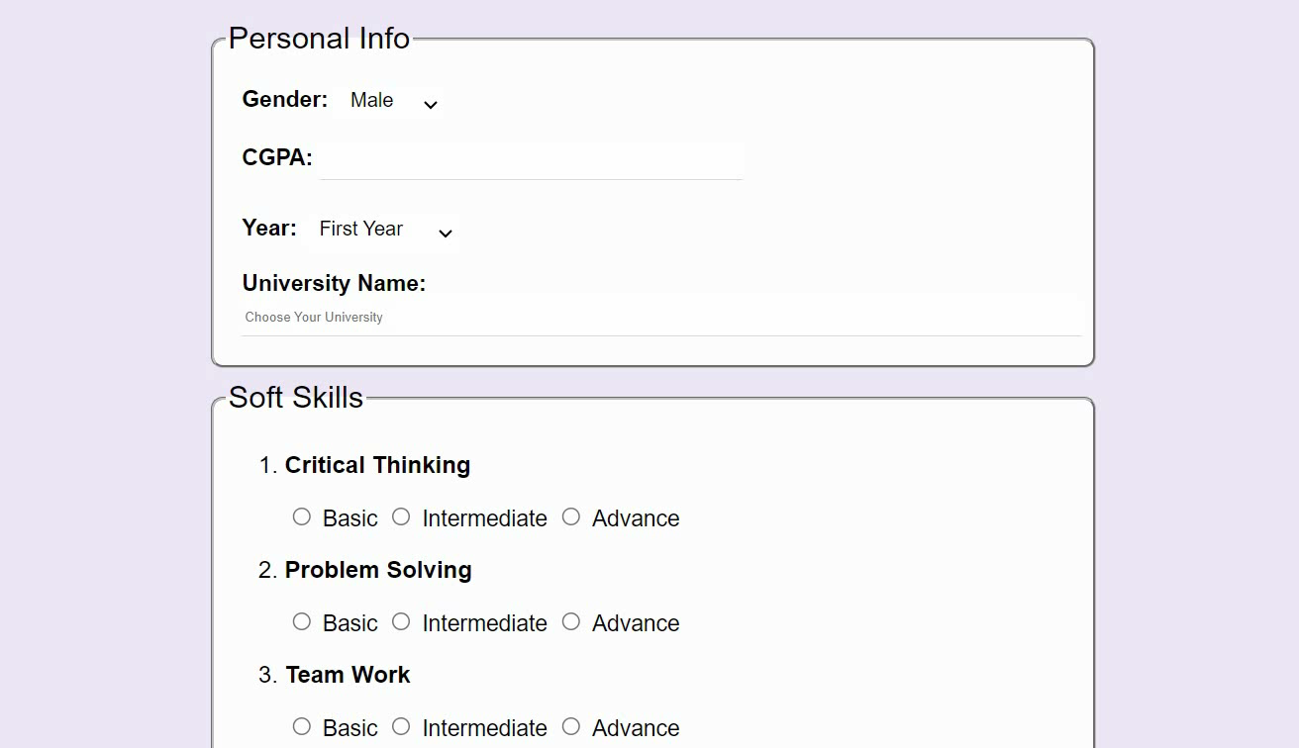
Proposed Methodology [2/2] Data Collection (Features)
DataCollectionForm[Link]

Slide 11
Results [1/6] statistical summary
Records |  | University | year
468 |  | 47 | 1st | 2nd | 3rd | 4th
Male | Female
 |  |  | 17 | 31 | 58 | 362
367 | 101

Slide 12
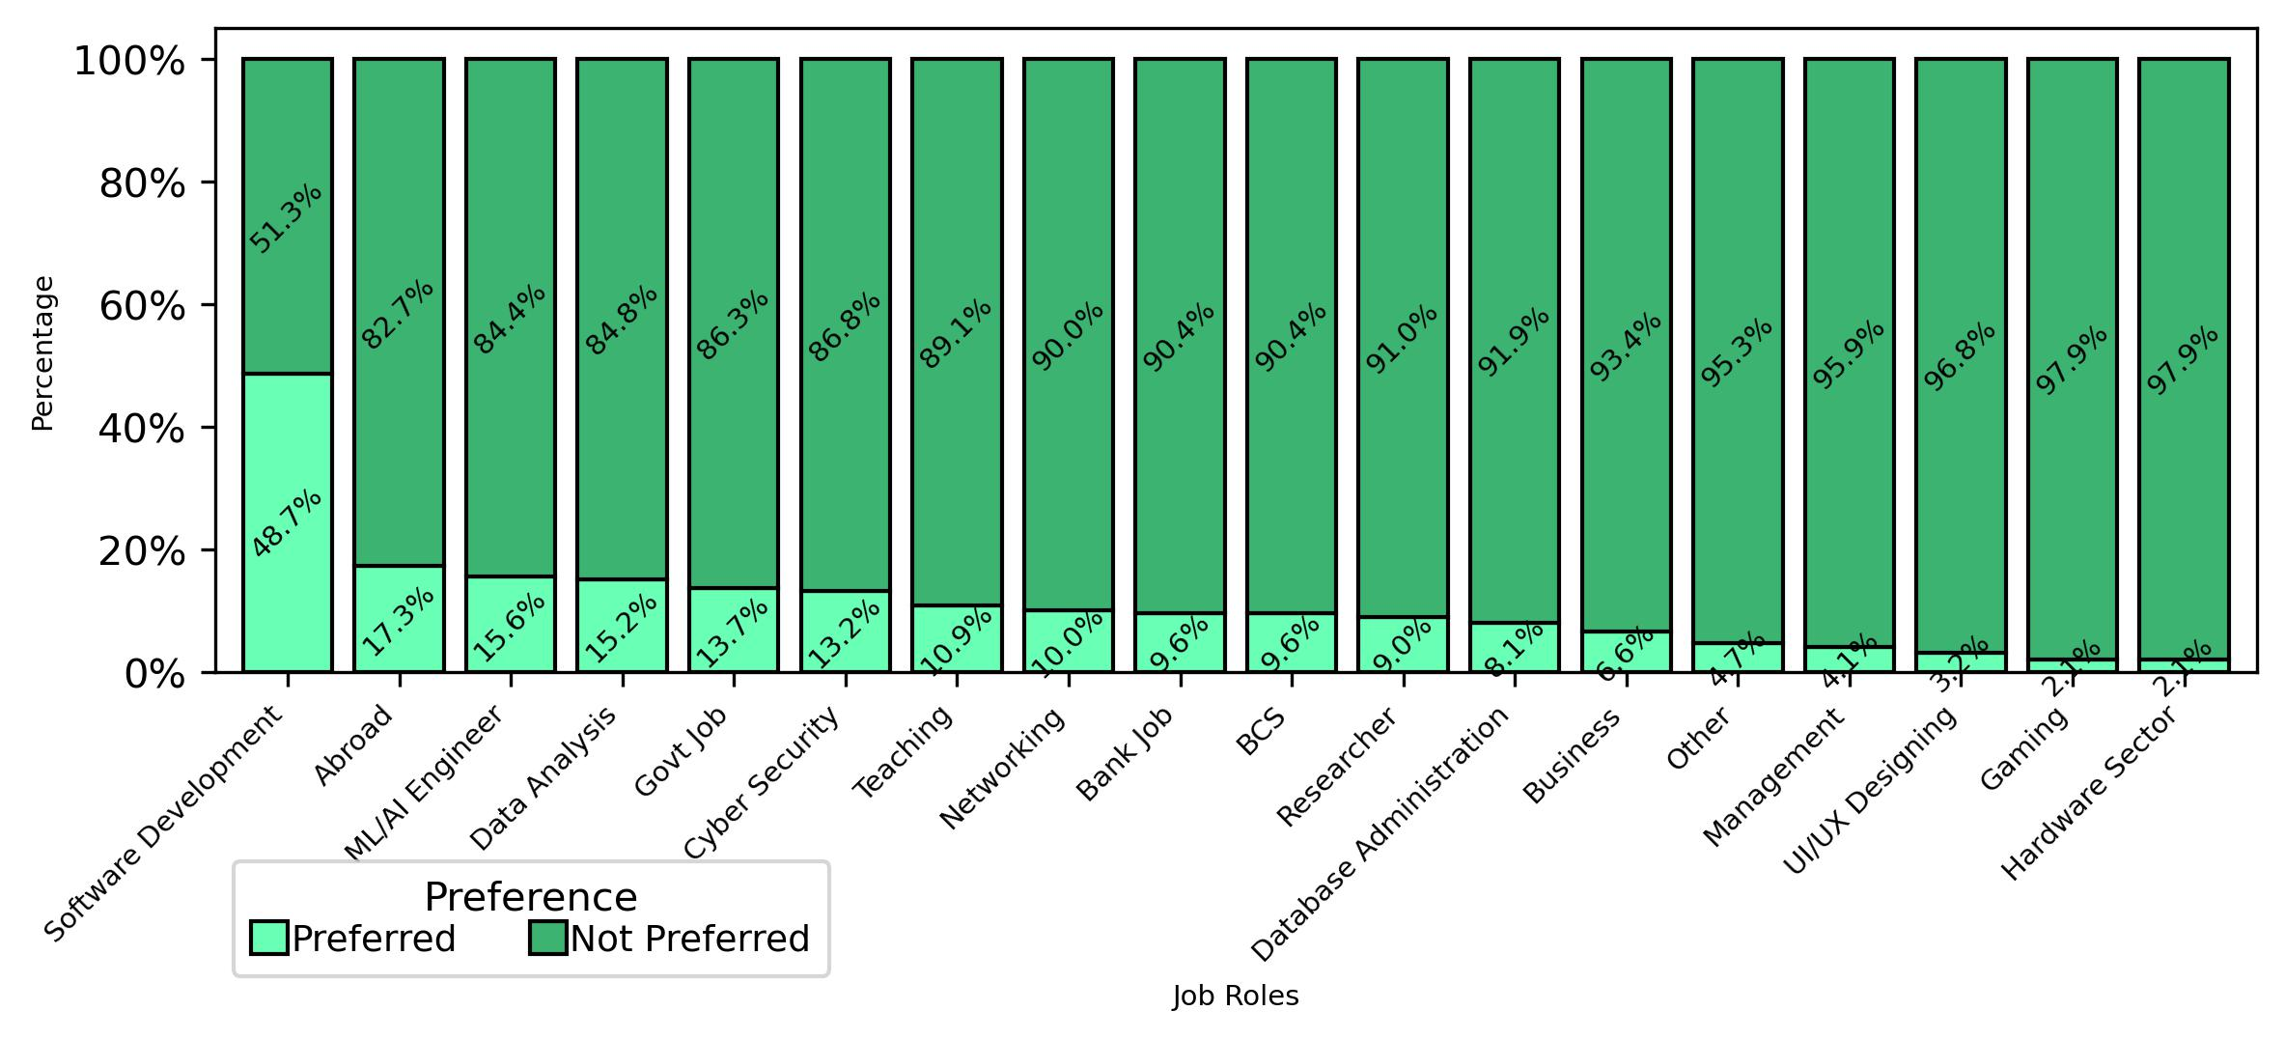
Results [2/6] Visualization of Job Distribution

Slide 13
Results [3/6] List of Algorithms
Logistic Regression
Decision Tree
Random Forest
Gradient Boosting
XGBoost Classifier
Hard Voting Classifier
Soft Voting Classifier
Support Vector Machine
Neural Network
K-Nearest Neighbors

Slide 14
Results [4/6] Model with 10 Algorithm
Algorithm | Accuracy | Precision | Recall | F1 (Micro) | F1 (Macro)
Logistic Regression | 0.42 | 0.81 | 0.62 | 0.70 | 0.53
Decision Tree | 0.37 | 0.67 | 0.68 | 0.68 | 0.52
Random Forest | 0.47 | 0.90 | 0.62 | 0.73 | 0.51
Gradient Boosting | 0.51 | 0.88 | 0.64 | 0.74 | 0.60
XGBoost Classifier | 0.61 | 0.85 | 0.73 | 0.79 | 0.69
Hard Voting Classifier | 0.51 | 0.89 | 0.66 | 0.76 | 0.60
Soft Voting Classifier | 0.51 | 0.82 | 0.70 | 0.76 | 0.65
Support Vector Machine | 0.43 | 0.80 | 0.58 | 0.67 | 0.46
Neural Network | 0.47 | 0.78 | 0.62 | 0.69 | 0.57
K-Nearest Neighbors | 0.55 | 0.87 | 0.63 | 0.73 | 0.53

Slide 15
Results [5/6] Best Model
XG Boost
F1 Micro (0.79)
Precision=0.85
Accuracy=61.7
F1 Macro (0.69)

Slide 16
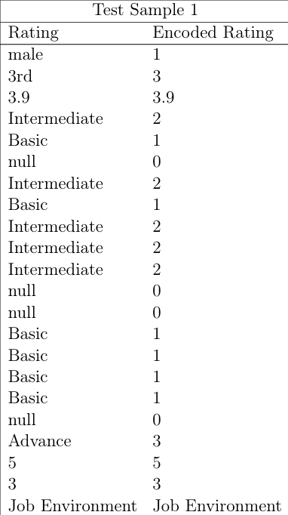
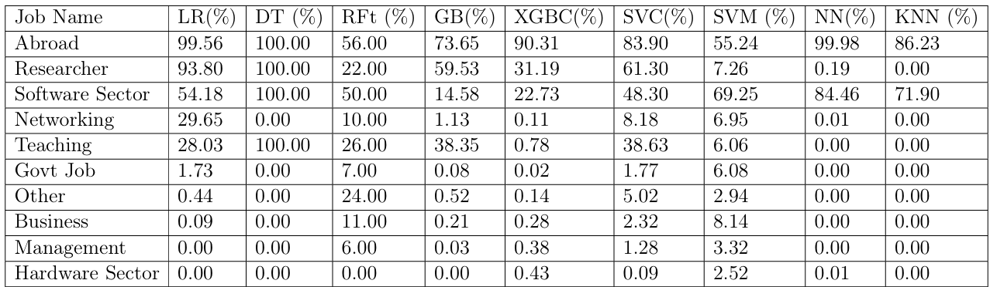
Results [6/6] A Sample Output
Input
Output

Slide 17
Challenges and Risks
Challenges
Risks
This case study aims to offer significant insights that will assist students from Bangladesh in making informed career choices.
It may not be feasible to capture data from every student.

Slide 18
Conclusion
Software development is most preferred job.
XGBoost Classifier is the best model to predict prefer job.
Model provide the prefer jobs sequentially according to the probability.

Slide 19
Thank you for your attention !

